Slide 1
Development of master curricula for natural disasters risk management in Western Balkan countries
NatRisk Project Web Site & Project Management Platform
Dejan Rančić
University of Niš, Faculty of Electronic Engineering
Kick-off meeting / 15th and 16th December 2016.
Project number: 573806-EPP-1-2016-1-RS-EPPKA2-CBHE-JP
"This project has been funded with support from the European Commission. This publication reflects the views only of the author, and the Commission cannot be held responsible for any use which may be made of the information contained therein"

Slide 2
Topics
Development of master curricula for natural disasters risk management in Western Balkan countries
Project Web Site
Project Management Platform

Slide 3
Project web site
Development of master curricula for natural disasters risk management in Western Balkan countries
Project web site is already created and can be accessed at:
www.natrisk.ni.ac.rs

Slide 4
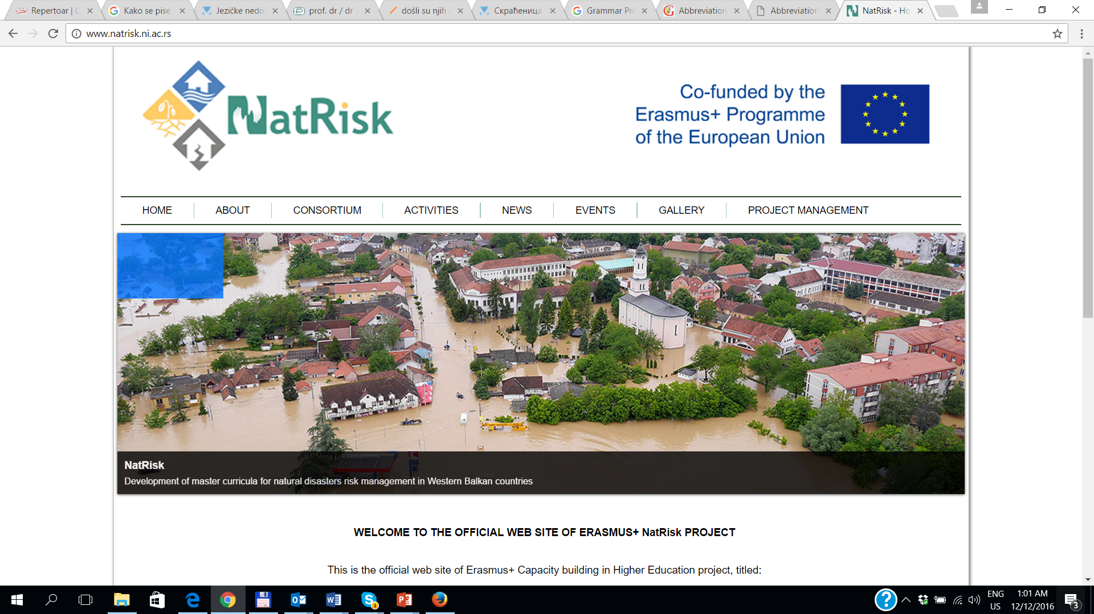
Project web site
Development of master curricula for natural disasters risk management in Western Balkan countries

Slide 5
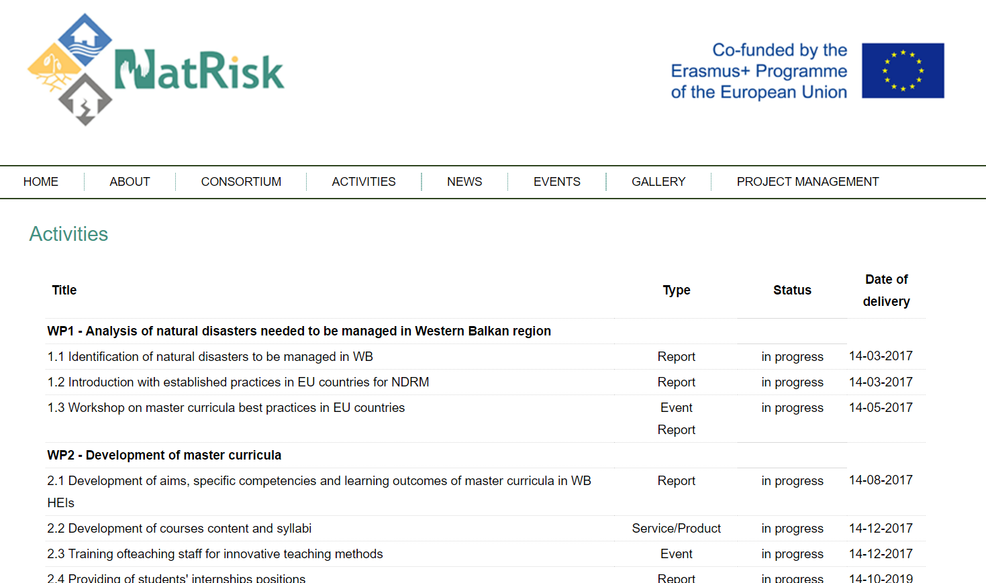
Project web site
Development of master curricula for natural disasters risk management in Western Balkan countries

Slide 6
What is Project Management Platform?
Development of master curricula for natural disasters risk management in Western Balkan countries
Documents and files management
Creating and tracking project issues
Making calendars – scheduling meetings
E-mail notification of any action

Slide 7
How to access to Project Management Platform?
Development of master curricula for natural disasters risk management in Western Balkan countries
natrisk.ni.ac.rs

Slide 8
Development of master curricula for natural disasters risk management in Western Balkan countries
Home Page
Projects
My account

Slide 9
Development of master curricula for natural disasters risk management in Western Balkan countries
Two basic Platform Management System Projects:
NatRisk Workpackages (WP1 – WP8)
NatRisk Financial mngt
Key Financial Documents
Staff Costs
Travel Costs & Costs of Stay
Equipment
Subcontracting
Special Mobility Strand
Co-financing
Financial mngt is assigned to each NatRisk partner separately
Users are grouped by
Roles (coordinators + partners)
Access rights
Each user may be a member of more then one group

Slide 10
Development of master curricula for natural disasters risk management in Western Balkan countries

Slide 11
Development of master curricula for natural disasters risk management in Western Balkan countries

Slide 12
Development of master curricula for natural disasters risk management in Western Balkan countries

Slide 13
Development of master curricula for natural disasters risk management in Western Balkan countries
PMP Projects
WorkPackages
Key Finacial Documents
Financial Mngt
WP1
WP2
WP3
WP4
WP5
WP8
Staff Costs
Travel Costs & Costs of Stay
Equipment
Subcontracting
Co-financing
WP6
WP7
Special mobility strand

Slide 14
Development of master curricula for natural disasters risk management in Western Balkan countries
Main Menu
Title bar
with Work Package label
Title bar
with Financial mngt label

Slide 15
Development of master curricula for natural disasters risk management in Western Balkan countries
Main Menu
Activity : find all issues (new and updated), uploaded files and documents
Calendar : find all important dates for your participation in NatRisk WorkPackage

Slide 16
Development of master curricula for natural disasters risk management in Western Balkan countries
Important Note: All issues, documents, meetings, calendar and activity inputs are related only to current WorkPackage which has been initially selected (visible in the title bar above Main Menu) !!!
WP1
Issue
WP2
Documents
Calendar
Meeting
Issue
Documents
Calendar
Meeting
Activity
Activity

Slide 17
Issues
Development of master curricula for natural disasters risk management in Western Balkan countries
Making new Issue
Updated existing issue
Choose WP
New Issue
E-mail notification of new issues to all users deployed on Work Package with a direct link to the new issue

Slide 18
Development of master curricula for natural disasters risk management in Western Balkan countries
New Issue

Slide 19
Development of master curricula for natural disasters risk management in Western Balkan countries
Types of Issues
Organize
Request information
Report
Support (discussion groups)

Slide 20
Development of master curricula for natural disasters risk management in Western Balkan countries
Issue Priority
Low
Normal
High
Urgent
Immediate

Slide 21
Development of master curricula for natural disasters risk management in Western Balkan countries
Start date + Due date
Issue Start date & Issue Due date is automatically added to Calendar to all users deployed on Work Package

Slide 22
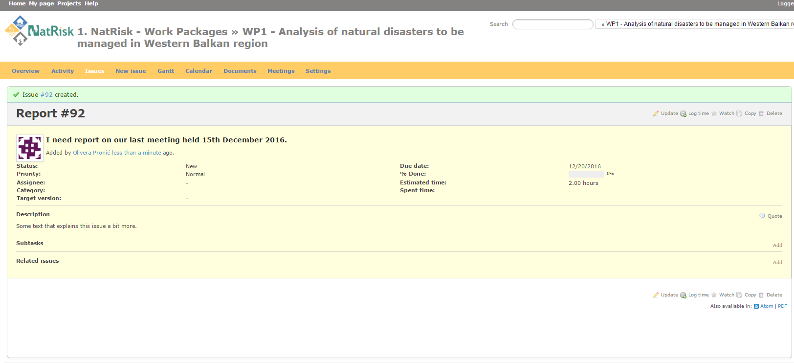
Development of master curricula for natural disasters risk management in Western Balkan countries

Slide 23
Development of master curricula for natural disasters risk management in Western Balkan countries
Issues
Subject is Hyperlink used to edit Issue
List of all Issues concerning user NatRisk WP participation are accessible through Issues or Activity from the Main Menu of certain Work Package

Slide 24
Development of master curricula for natural disasters risk management in Western Balkan countries
Update

Slide 25
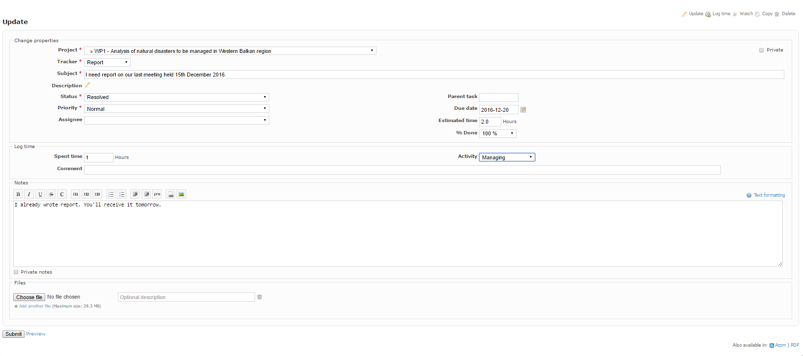
Development of master curricula for natural disasters risk management in Western Balkan countries
Status of updated issue
In Progress
Resolved
Feedback
Closed
Rejected
Priority of updated issue
Low
Normal
High
Urgent
Immediate

Slide 26
Development of master curricula for natural disasters risk management in Western Balkan countries
Issue main window with latest data
(status + priority + descriptions + uploaded files etc.)
Issue updates History with all important steps have been taken during issue update

Slide 27
Documents
Development of master curricula for natural disasters risk management in Western Balkan countries
Choose WP
Select Documents
Upload document
E-mail notification of new uploaded documents to all users deployed on Work Package with a direct link to the new document

Slide 28
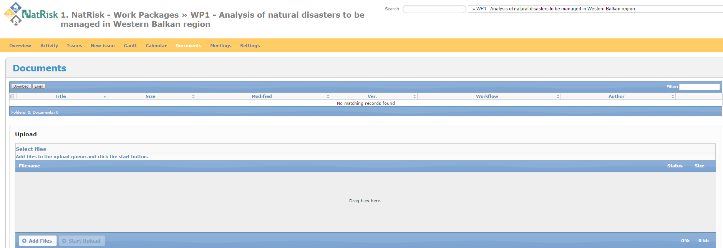
Development of master curricula for natural disasters risk management in Western Balkan countries
Documents

Slide 29
Development of master curricula for natural disasters risk management in Western Balkan countries

Slide 30
Development of master curricula for natural disasters risk management in Western Balkan countries

Slide 31
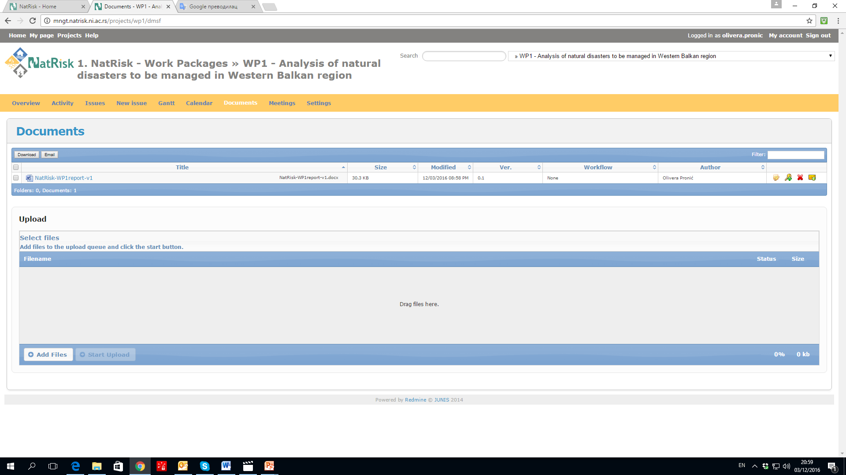
Development of master curricula for natural disasters risk management in Western Balkan countries
Documents
List of all Documents concerning user participation into NatRisk WP are accessible through Documents or Activity from the Main Menu of certain Work Package

Slide 32
Development of master curricula for natural disasters risk management in Western Balkan countries
Modified
Title
Size
Version
Author
Documents may be downloaded, edited by another user and uploaded again

Slide 33
Development of master curricula for natural disasters risk management in Western Balkan countries
Hyperlink used to download Document
Document details Icon
to add new revision of Document

Slide 34
Development of master curricula for natural disasters risk management in Western Balkan countries
Documents Details
Use to upload revised version of Document
Icon used to download Document

Slide 35
Development of master curricula for natural disasters risk management in Western Balkan countries
Updated (changed) file may be uploaded with the same or with a different name.
System will recognize File with the same Title and it will automatically change file Version (0.1 – 0.2 - 0.3 etc.)
E-mail notification of uploaded updated versions of documents to all users deployed on Work Package.
WP3-Doc1 Version 0.1
By User 1
WP3-Doc1 Version 0.2
By User 2
WP3-Doc1 Version 0.3
By User 3

Slide 36
Development of master curricula for natural disasters risk management in Western Balkan countries

Slide 37
Development of master curricula for natural disasters risk management in Western Balkan countries
Document details Icon
to see all previous versions of Document
Version 2
Hyperlink used to download latest version of document

Slide 38
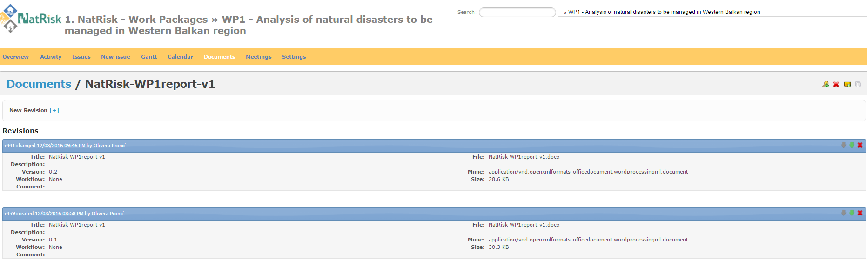
Development of master curricula for natural disasters risk management in Western Balkan countries
Documents Details
Icon used to download specific version of Document

Slide 39
Calendar
Development of master curricula for natural disasters risk management in Western Balkan countries
Choose WP
Select Calendar
Calendar contains all WP Issues – Beginning & Ending days

Slide 40
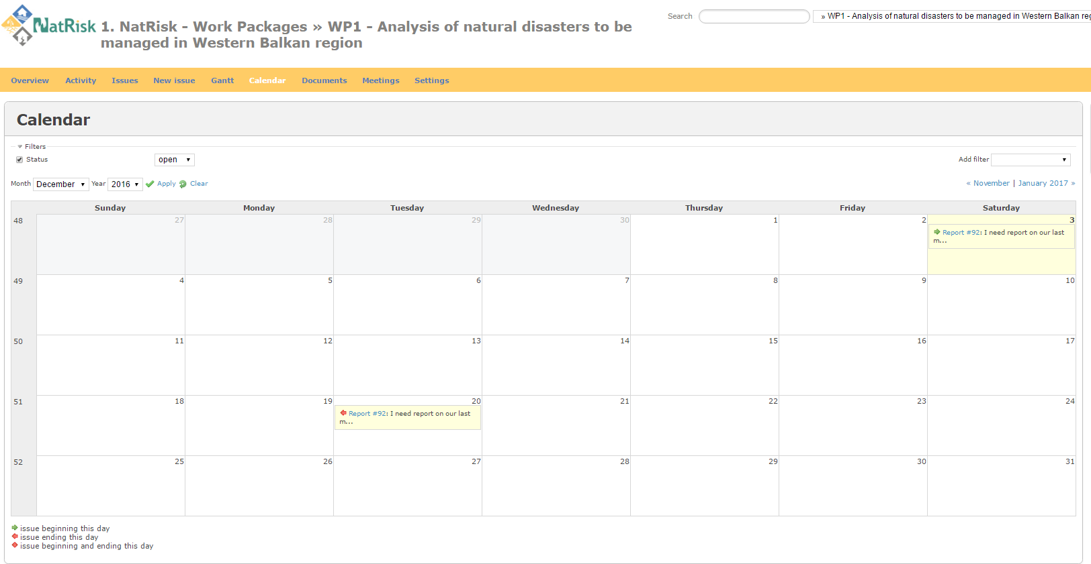
Development of master curricula for natural disasters risk management in Western Balkan countries
Calendar

Slide 41
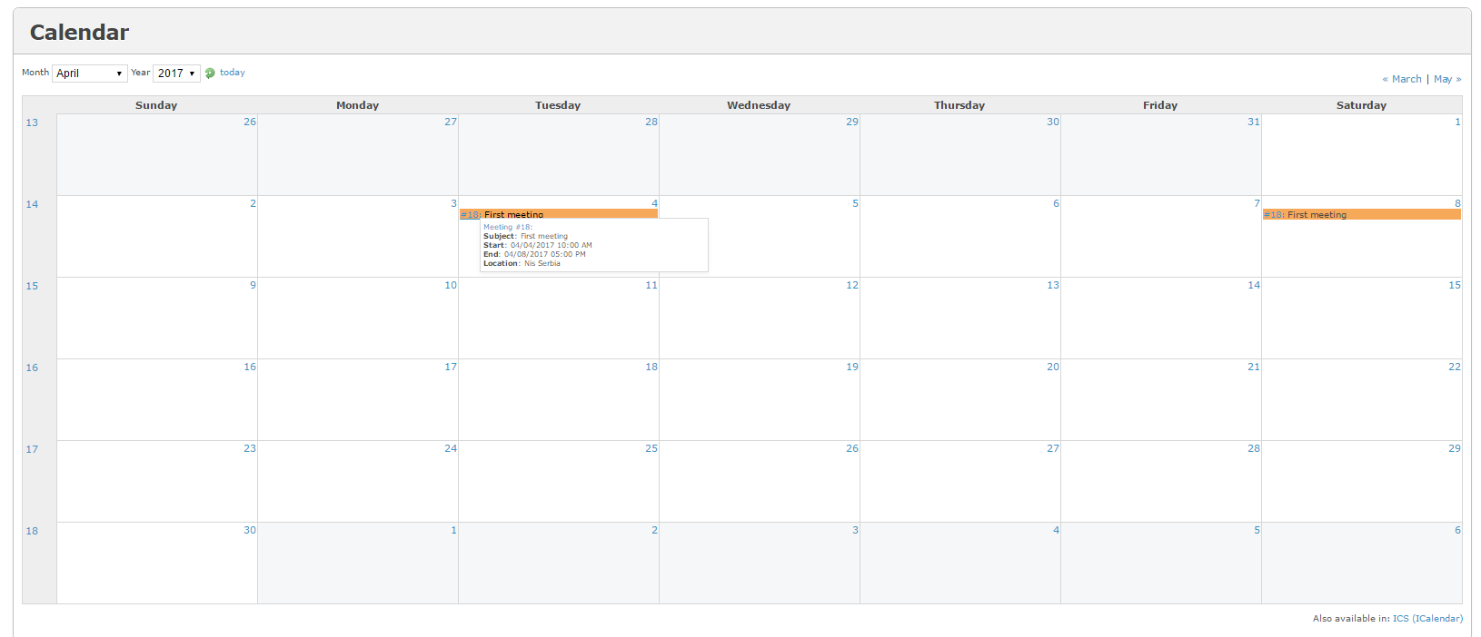
Development of master curricula for natural disasters risk management in Western Balkan countries
Hyperlink used to track Issue through Calendar

Slide 42
Meetings
Development of master curricula for natural disasters risk management in Western Balkan countries
Choose WP
Select Meetings
Schedule new Meeting
Start new Doodle (simplifies the process of scheduling events, meetings, appointments)
E-mail notification of New Meetings and New Doodles

Slide 43
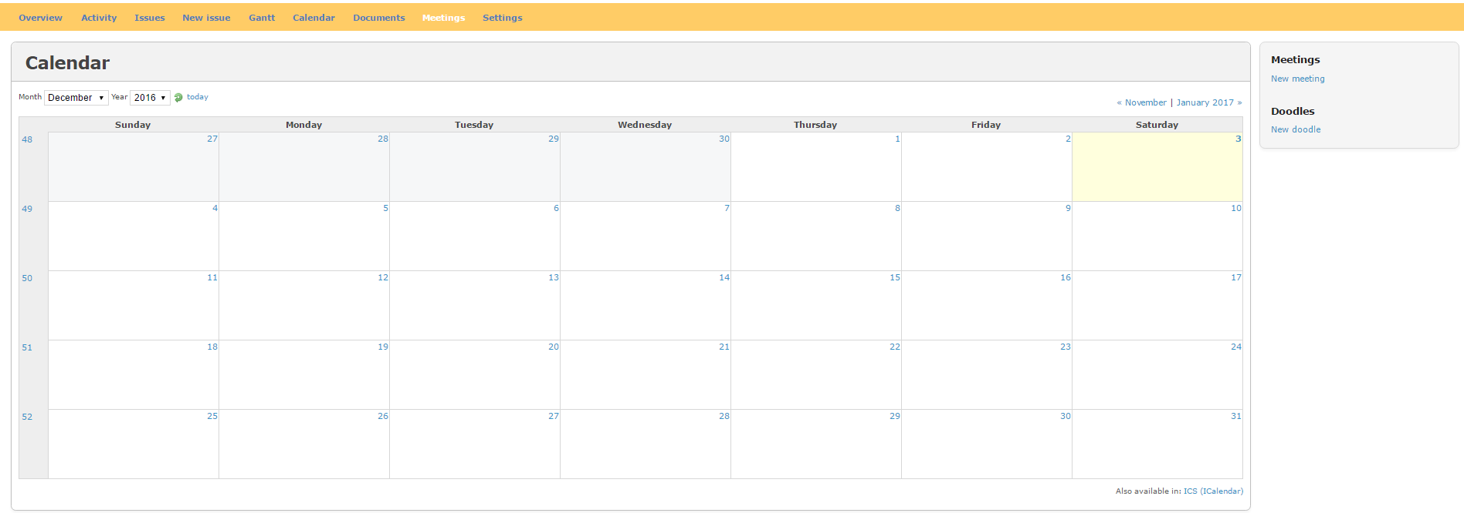
Development of master curricula for natural disasters risk management in Western Balkan countries
MeetingCalendar
New meeting

Slide 44
Development of master curricula for natural disasters risk management in Western Balkan countries

Slide 45
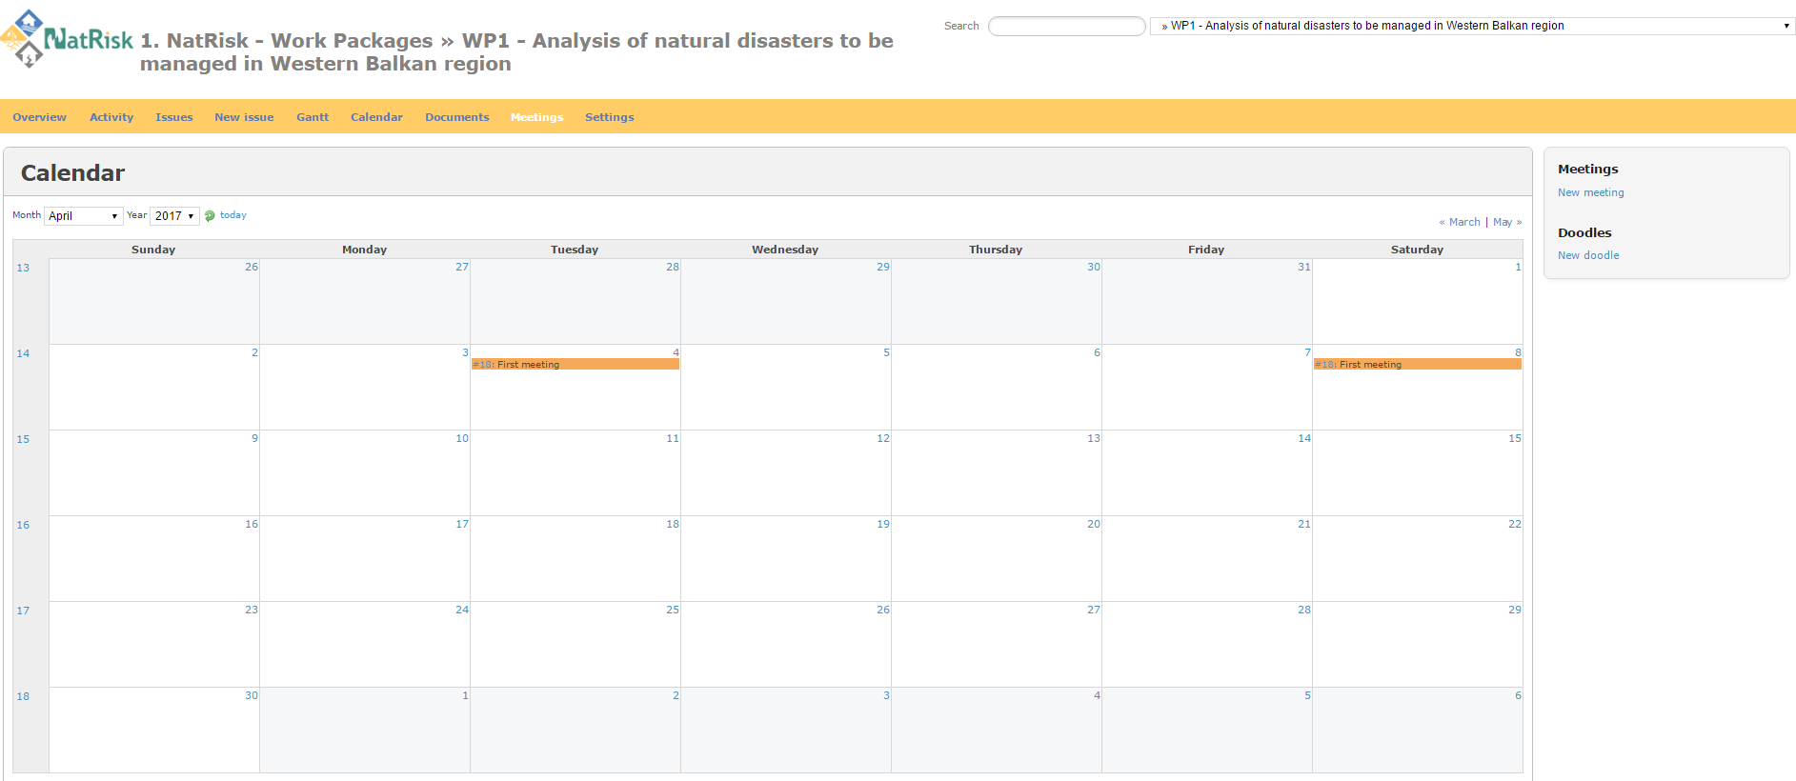
Development of master curricula for natural disasters risk management in Western Balkan countries
Hyperlink used to track Meeting through Calendar

Slide 46
Development of master curricula for natural disasters risk management in Western Balkan countries
Download attached file

Slide 47
Development of master curricula for natural disasters risk management in Western Balkan countries
New Doodle
simplifies the process of scheduling events, meetings, appointments
MeetingCalendar

Slide 48
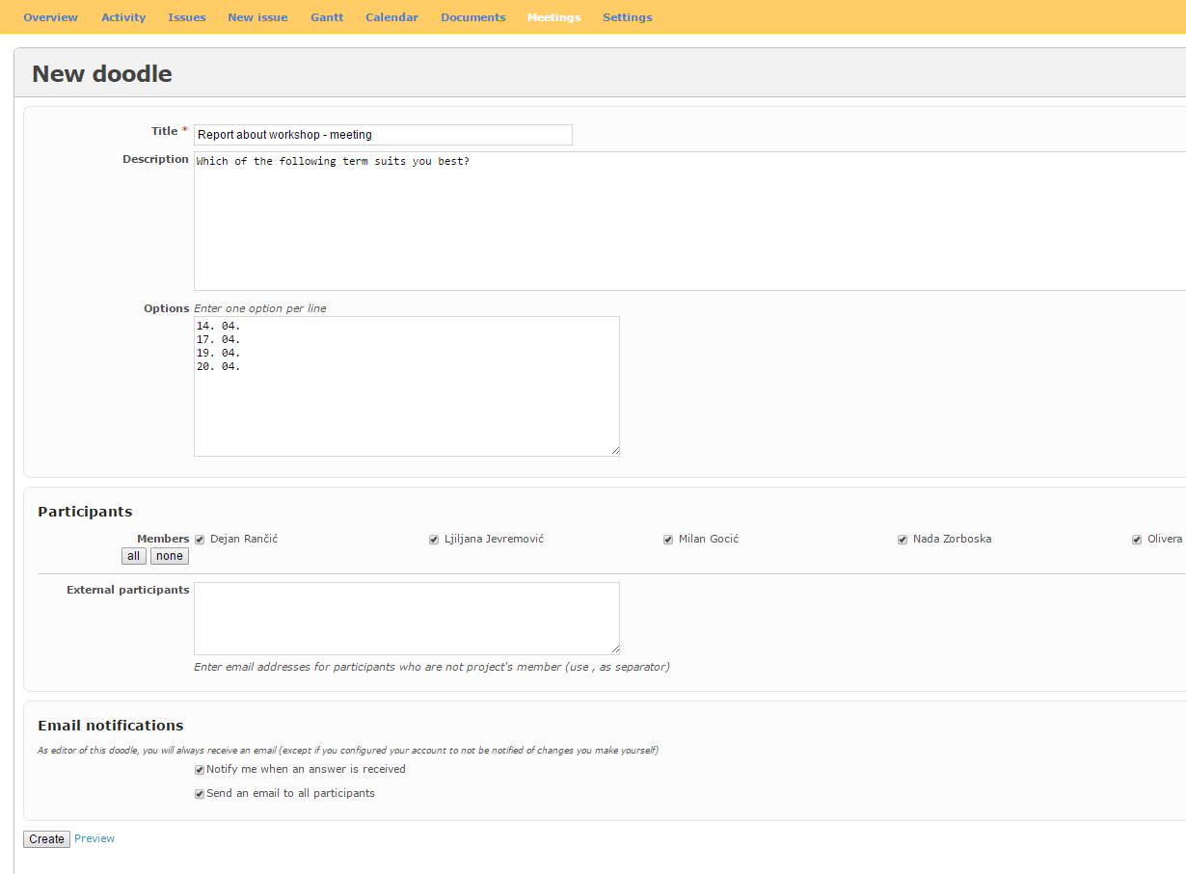
Development of master curricula for natural disasters risk management in Western Balkan countries

Slide 49
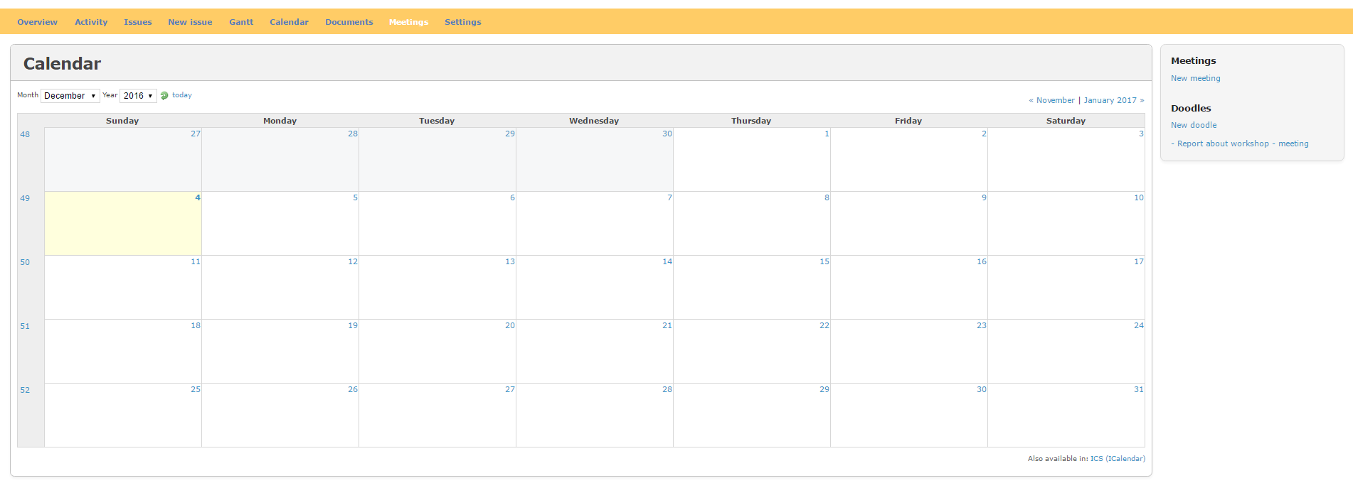
Development of master curricula for natural disasters risk management in Western Balkan countries
Doodles
List of active doodles

Slide 50
Development of master curricula for natural disasters risk management in Western Balkan countries
Vote for the proposed meeting time that is most convenient for you

Slide 51
Thanks for your attention!!!
Development of master curricula for natural disasters risk management in Western Balkan countries

